Slide 1
Leveraging AI/ML for plastic marine debris
Presented By:
Chaital D. Magade Rais Alluaddin Mulla
B.E.-Electronics & Telecommunication. B.E (InformationTechnology)
PG - Cloud Computing. M.E. Computer Engg.

Slide 2
Introduction
Marine debris is one of the most pervasive threats to the health of coastal areas, oceans, and waterways. challenge is to leverage Artificial Intelligence/Machine Learning to monitor, detect, and quantify plastic pollution and increase our understanding about using these techniques for this purpose.
Plastics are one of the most extensive types of marine debris. They are commonly used in many items, and as society has developed new uses for them the variety and quantity of plastic items found in the marine environment has increased dramatically. Plastics are now known to break down into smaller components, called microplastics. Microplastics and their associated toxic chemical components contribute to human and wildlife health risks as the toxic microplastics are ingested and move through the marine food web.
This mismanaged waste degrades our ecosystems, affects the health of marine life, and threatens sectors within the economy that rely on the well-being of the marine environment, including fishing and tourism.

Slide 3
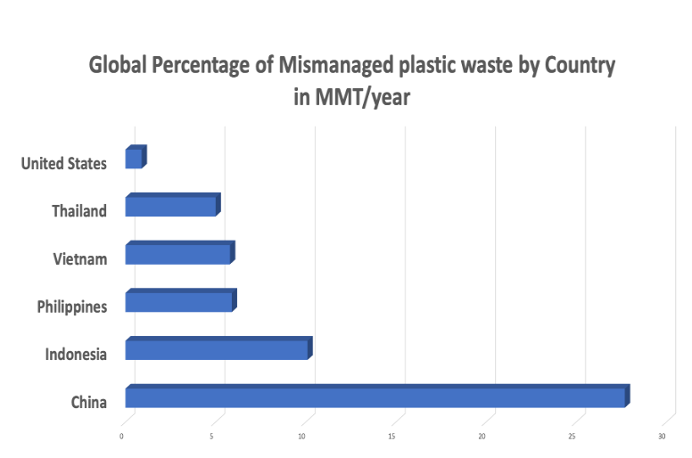
As shown in the figure to the left, the most recent data indicates that China contributed the highest share of mismanaged plastic waste with around 28 percent of the global total, followed by Indonesia (10 percent), the Philippines and Vietnam (both 6 percent), and Thailand (5 percent).

Slide 4
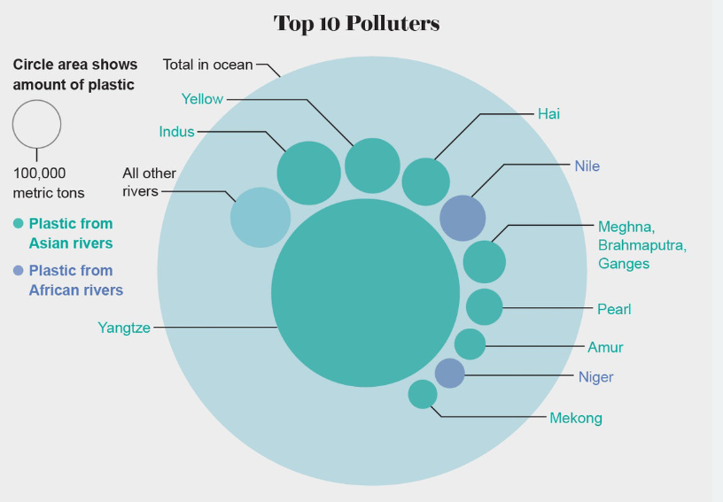
Marine Litter Costs
California, a 2018 study estimated that doubling the amount of marine litter on beaches would result in an estimated loss of $414 million in tourism dollars, and a decrease of nearly 4,300 jobs.vi Additional economic costs from marine litter may include those associated with clean-up operations including litter removal. Communities along the West Coast of the U.S. spend over half a billion dollars a year on the clean-up of beaches and waterways, street-sweeping, the installation of storm-water capture devices, the cleaning and maintenance of storm drains, the manual clean-up of litter, and public anti-littering campaigns to clean up and prevent marine litter.

Slide 5
Together, We Can Address the Challenge
1.Building capacity for better waste and litter management systems, including through improving infrastructure, government coordination, and public education and engagement. 2. Incentivizing the global recycling market in partnership with the private sector. 3. Promoting research and development for innovative solutions and technology. 4. Promoting marine litter removal, including litter capture systems in seas, rivers and inland waterways.
5. Implementation of Machine Learning/ Artifical Intelligence
by gathering Data in form of video, photo and doing survelliance, generating alerts.

Slide 6
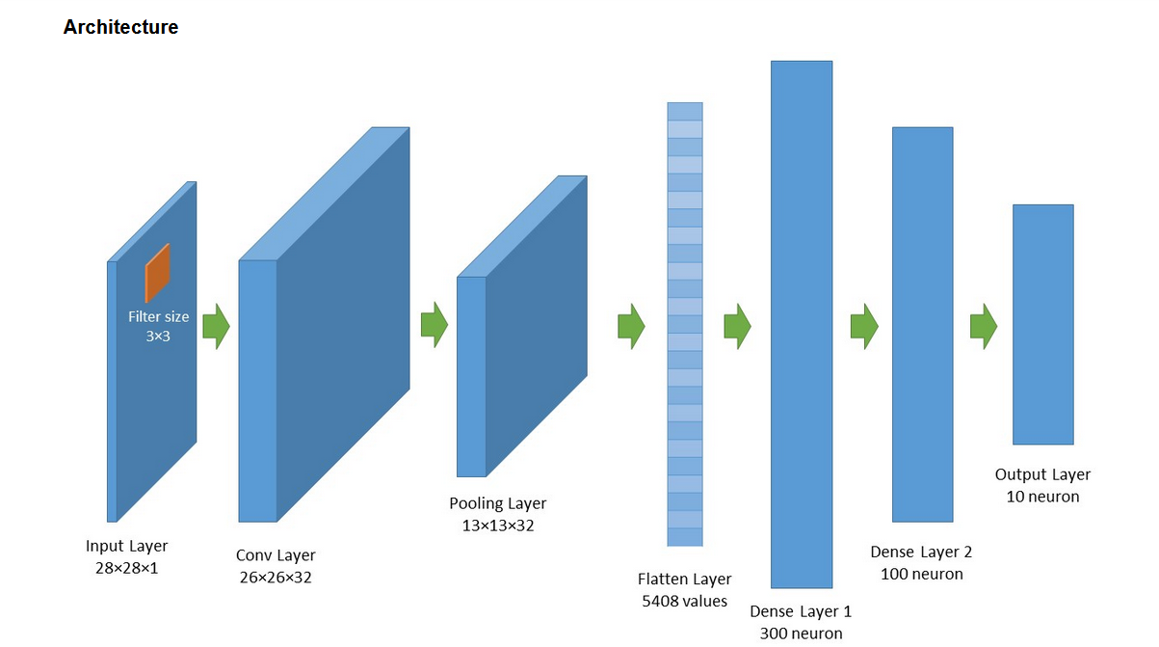
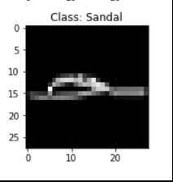
Implementation of Artificial Intelligence using Convolutional Neural network
On the left we see an architecture of convolution neural network been implemented to detect plastic object(Marine Debris)
There are various methods such using YOLO.
By power of cloud computing and big data analytics. Procressing of Data and object detection can be done on faster scale.
So this can serve as a model for governments and the private sector to identify strategic methods for building capacity in systems to detect plastic waste and litter. Some of these may include improving infrastructure, collection systems, government coordination, and public education and engagement, incentivizing the global recycling market in partnership with the private sector; advancing research into, and the development of innovative solutions and technology; and promoting the removal of marine debris.

Slide 7
Conclusion
The flow of mismanaged plastic waste into our waters is threatening critical natural resources, economies, and industries around the world.
Marine debris is preventable through increased public awareness, changing individuals’ behaviors, and movement towards an economy of reduced pollution and waste.
Educating the AI system through constant feeding of data making it more intelligent. Modifying the existing algorithm for using less computation power and to bring productive results in less time

